Slide 1
International
Female Solo Artist
Башаева Ирина Алексеевна
учитель английского языка
МКОУ СОШ с. Непа

Slide 2
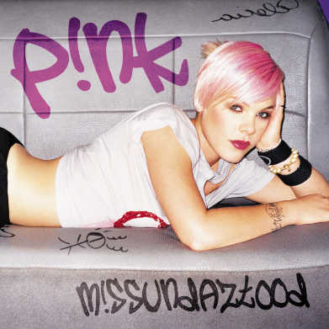
Voice and timbre
Career
resources
Family
Influences
Beginning
Public image

Slide 3
P NK
i
Date of birth: 08/09/ 1979
Birth name: Alecia Beth Moore
Zodiac: Virgo
Place of birth: Abington, Pennsylvania, US
Occupations:
Singer-songwriter, musician, dancer, actress, model
Instruments: Vocals, guitar, piano, keyboards, drums, bass

Slide 4
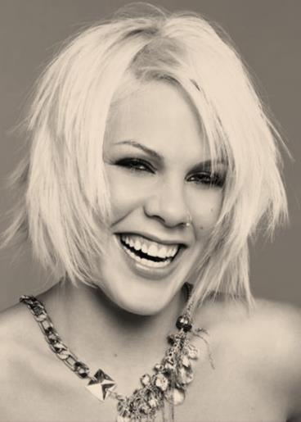
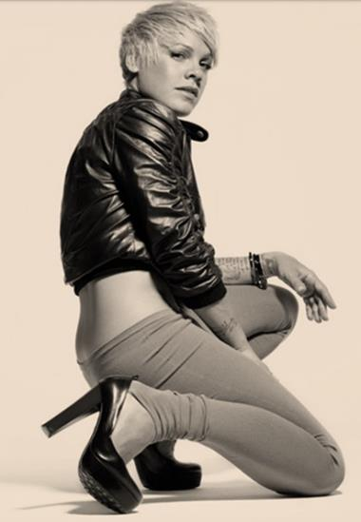
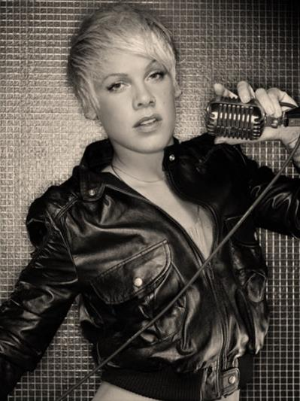
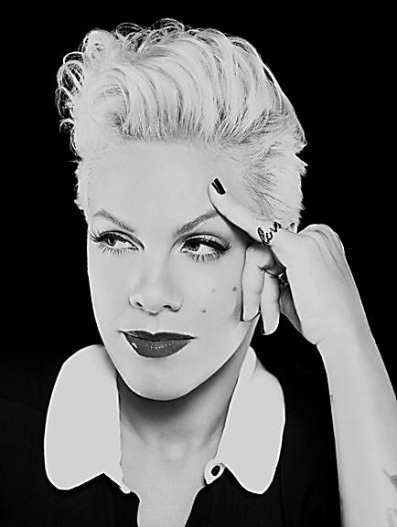
Alecia Beth Moore (born September 8, 1979), better known by her stage name Pink (stylized as P!nk) began her solo career with the 2000 single "There You Go" which was also included in her debut album, Can't Take Me Home.
In November 2003, Pink released her third album, Try This, preceded by the single "Trouble". After a short hiatus, her fourth studio album, I'm Not Dead, was released in April 2006. Pink's fifth album, Funhouse, was released in late 2008 and was preceded by her first solo number one on the Billboard Hot 100,
"So What". The album was certified double-platinum in the US and prompted Pink to go on the record-breaking Funhouse Tour.
Pink has become one of the most successful artists of her generation, having sold over 45 million records worldwide as of 2013. Her career accolades include three Grammy Awards, a Brit Award, and six MTV Video Music Awards. Additionally, Pink has had 19 top-twenty hits on the Billboard Hot 100. In 2009, Billboard magazine named Pink the 1 pop musician of the decade, in 2012 VH1named Pink the 10 on their list of the 100 Greatest Women in Music, and in 2013 Billboard named Moore the Woman of the Year.
Her first compilation album, Greatest Hits...
So Far!!!, was released in November 2010 and produced two chart-topping singles, "Raise Your Glass" and "Fuckin' Perfect". Her latest album, The Truth About Love, was released in 2012 and became her first number one album in the United States.
According to the RCA record's Pink is the best selling female artist of 2013 with 886,000 albums sold.
Although she originally faced opposition from her record label, Pink aimed to make her second album more personal and more pop rock-oriented. The product, 2001's Missundaztood, proved to be her most successful album to date, with sales in excess of 12 million copies.

Slide 5
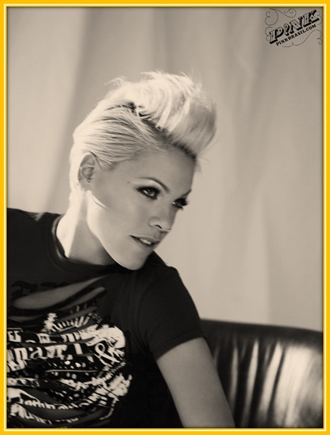
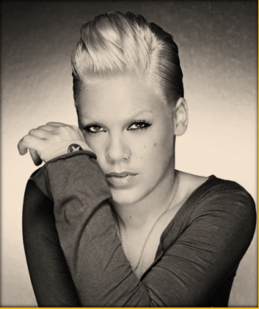
Madonna is also one of her biggest influences. Pink has stated "I'd seen artists change styles and fail miserably, but I've also seen artists change and continue to do well. That's why Madonna has always been an inspiration for me."
I was a fan right from the first time I heard 'Holiday.' Other influences include Joan Jett, Mary J. Blige, Billy Joel, Linda Perry, and Whitney Houston.
Pink has named Janis Joplin as her biggest musical influence, saying "She was so inspiring by singing blues music when it wasn't culturally acceptable for white women, and she wore her heart on her sleeve. She was so witty and charming and intelligent, but she also battled an ugly-duckling syndrome. I would love to play her in a movie."

Slide 6
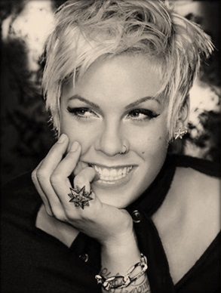
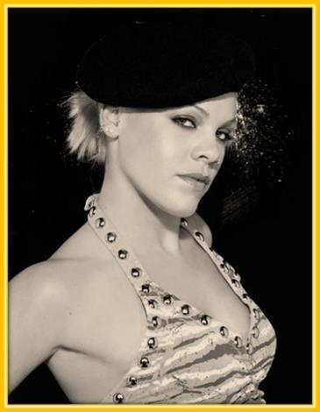
The Inquirer defined her voice as "husky" and "gutsy", further complimenting her for developing into a "powerfully emotive vocalist", while comparing her to Janis Joplin. The Star Tribune commends her by writing, "Her slightly raspy, slightly soulful voice made you feel the dysfunction in 'Family Portrait', the longing of 'Who Knew' and the empowerment in 'Perfect'." CNN stated that Pink is known for singing "with the right level of emotion". Fellow pop artist Kelly Clarkson believes that Pink's voice is "the best of our generation".
Pink has a contralto vocal range. Her voice is regarded as one of the greatest in pop music, and she refuses to use pitch correction in her recordings. Throughout her career, she has received applause from critics for her powerful vocals. Her voice has been described as "raspy", "husky", and "distinctive". James Montgomery of MTV calls her "a deceptively good singer who can out-sing almost anyone". The Guardian describes her voice as "prodigious".

Slide 7
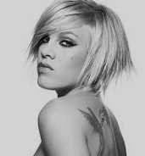
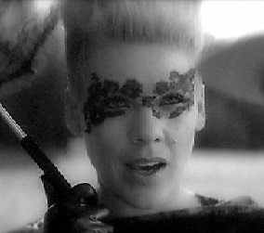
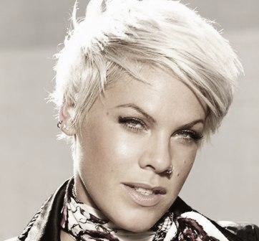
Pink is a prominent campaigner for PETA, contributing her voice toward causes such as the protest against KFC. In conjunction with PETA, she criticized the Australian wool industry over its use of mulesing. In January 2007, she stated that she had been misled by PETA about mulesing and that she had not done enough research before lending her name to the campaign. Her campaigning led to a headlining concert called PAW (Party for Animals Worldwide) in Cardiff, Wales on August 21, 2007.
Pink, aside from her musical feats, has also become known for her style and work outside of music. She has often been seen as "adventurous" with her hair, and has had styles such as fluorescent spikes to pink-streaked dreadlocks to a pitch-black skater cut. Regarding her style, she told InStyle "I'm eclectic. I'm a tomboy, but I'm kind of a hippie and kind of a gangster. I don't know if that's a good thing, but it is my thing."
Pink is also involved with several charities, including Human Rights Campaign, ONE Campaign, Prince's Trust, New York Restoration Project, Run for the Cure Foundation, Save the Children, Take Back the Night, UNICEF and World Society for the Protection of Animals.
In August 2012, Pink became a spokes model for CoverGirl, featuring in a fall 2013 advertising campaign themed "beauty with an edge".

Slide 8
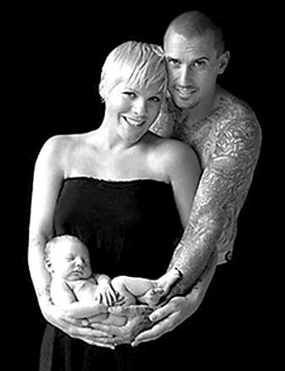
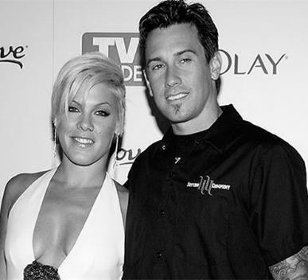
Pink met professional motocross racer Carey Hart at the 2001 X Games in Philadelphia. Following a brief separation in 2003, Pink proposed to Hart in June 2005 during a Mammoth Lakes motocross race; she was "assisting" in his race and wrote "Will You Marry Me? I’m serious!" on a pit board. He initially didn't notice and continued on for another lap. When he did notice later, he veered off the track to accept right then. She made him finish the race because she wouldn't marry a loser. They married in Costa Rica on January 7, 2006.
In November 2010, Pink announced on The Ellen DeGeneres Show that she and Hart were expecting their first child. On June 2, 2011, Pink gave birth to their daughter, Willow Sage Hart.

Slide 9
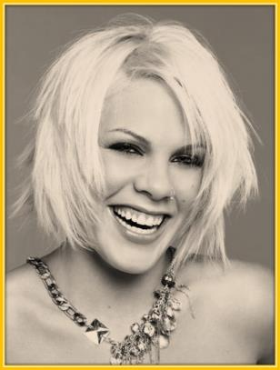
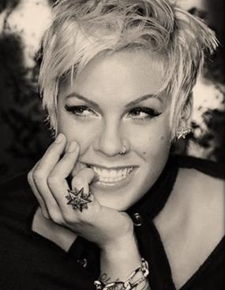
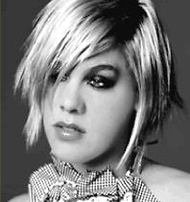
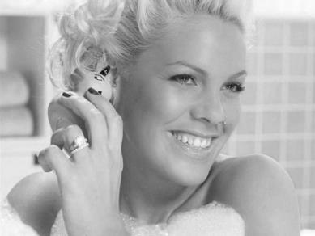
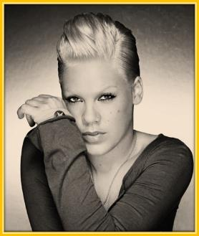
The girl had to go to school, but she was often driven out because of indecent questions asked to her teachers. It didn't promote creation of good relations between future singer and teachers and therefore Alisa used to each opportunity to ignore school. Moreover, when the child was twelve years old, she found more interesting passion. Having fallen in love with dances Ms. Moore was engaged in them days and nights since the childhood.
.
Her passion for dancing the girl very effectively combined with music lessons. At thirteen Pink joined the amateur rap group. The group was called Schools Of Thought. At that time the girl started singing and writing texts for her own compositions. It was simple because Alishiya had vocal skills from her birth and words came out from under her hands themselves
Trying to get into the world of show business, Alicia realized that a decent vocal is only a small part of her work. It is constantly necessary to think about how to attract media attention, how to find a good producer and make your own music «business» to work and bring profit. In general, it was very difficult, and the prospects of Pink were not particularly bright. But being a proud American, she decided to go on her way, come what may!
The full name of Pink is Alecia Moore (Alicia Moore). Certainly Pink is not an example of modesty. «Wherever I go, I leave a chaos, " she says. - I want to say honestly: I just want to attract attention. Whenever I am there is no chance for boredom!» Pink was born September 8, 1979, in Philadelphia. She had a passion for music from her childhood.
Soon the band parted, but Pink did not bother about it. In less than a few months, she has already consolidated her initial success. She began singing in the group Basic Instinct and signed a contract with a solid record company MCA Records. However, in a few months this group was disbanded, and the singer has joined a new group Choice.
Some time later, Pink realized that the best she could do is to leave the group. For some time she was even disappointed with music business. Later, the singer admitted in her interview: «All my illusions about the music world and my place in it were completely destroyed. When I was little, I thought that the singer only needs to stand on a stage and sing. It became clear that it was not so.»

Slide 10
Information resources
http://en.wikipedia.org/wiki/Pink_(singer)
http://www.westmusic.ru/pop/pink/
http://www.uznayvse.ru/znamenitosti/%D0%BF%D0%B8%D0%BD%D0%BA.html
‎http://www.pinkspage.com/ru/home

